Slide 1

Empowering Healers
Presented by: Shyama Dutta
Leadership & Learning Consultant
Pune | shyamad@gmail.com | +91 9890308322

Slide 2
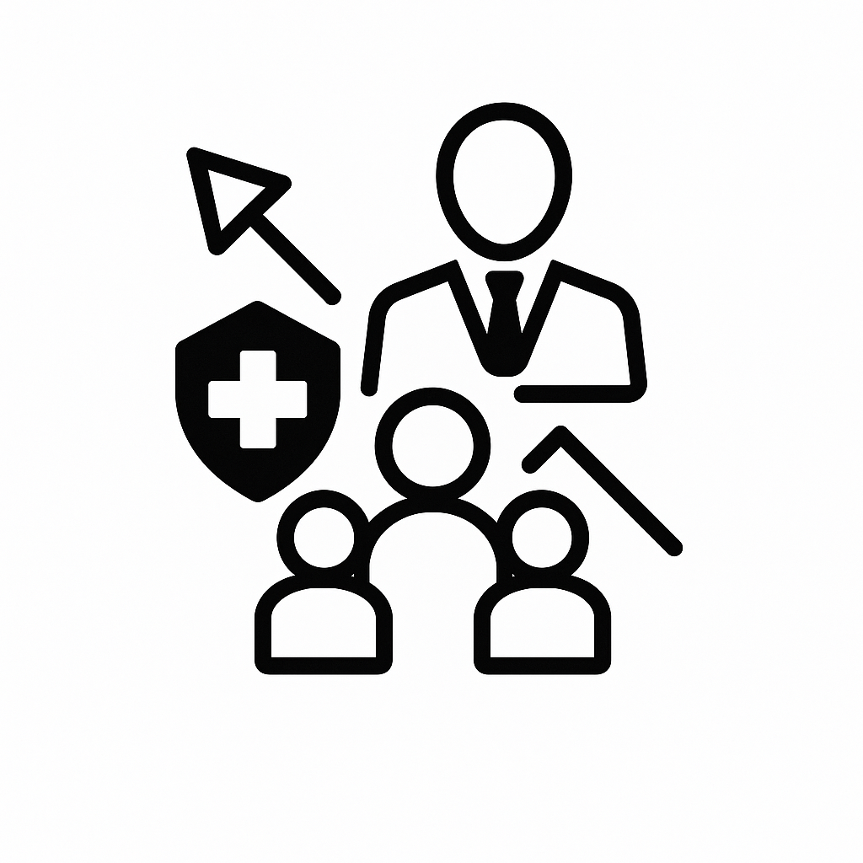
Key Challenges in Hospital Services
Strengthening management training will help first-time leaders enhance patient engagement and service excellence
Global patients expect hospitality-level care aligned with international standards
Indian patients seek seamless, personalized service experiences
Senior consultants are expected to build and sustain trust at a global level
Need to deepen behavioral and communication skills across front line teams
Compliance and ethics require engaging and culturally resonant delivery
Aligning senior staff to effectively shape and reflect the hospital’s brand values through their leadership.

Slide 3

Human-Centered Training1/2
First-Time Leader Development
Training Focus: Team management, coaching, emotional intelligence
Target Audience: Mid-level doctors & consultants, nursing supervisors, administrative staff, mid level doctors & consultants
Behavioral Excellence for a Global Patient Experience
Training Focus: Patient centric dialogue, cross-cultural communication, global etiquette,
Target Audience: Junior doctors, nurses, front office teams
Strategic Leadership & Personal Branding
Training Focus: Executive presence, crisis communication, digital reputation management
Target Audience: Senior consultants, department heads (HODs), communication department

Slide 4
Human-Centered Training -2/2
Marketing & Internal Brand Alignment
Training Focus: Strategic storytelling, brand alignment, doctor-media interaction
Target Audience: Marketing teams, communication specialists, department heads
Compliance, Ethics & Inclusion
Training Focus: Scenario-based learning for POSH, DEI, and ethical decision-making
Target Audience: All levels, from frontline staff to senior leadership
Innovation Labs
Training Focus: Patient journey mapping, workflow optimization, collaborative problem-solving
Target Audience: Cross-functional leaders and transformational teams
Notes:
Innovation Labs spark cross-functional thinking to reimagine patient care, streamline workflows, and co-create breakthrough solutions.
Patient Journey Mapping
Shifts focus from departmental efficiency to end-to-end patient experience
Encourages empathy-driven redesign of services
Workflow Optimization
Goes beyond routine process improvement — it aims to reimagine operations through cross-disciplinary collaboration
Uses data and human insight to create smarter, faster, more human-centered systems
Collaborative Problem-Solving
Breaks silos by involving nurses, doctors, admins, and technicians in shared ideation
Creates transformational teams that co-create rather than merely execute
Cross-Functional & Transformational Teams
Innovation lies in how people think and work together, not just what they build
These labs become living prototypes of a new work culture

Slide 5

Tangible Outcomes
Strategic leadership building trust and unity strengthens the hospital’s voice within India and beyond.
Higher engagement and satisfaction among global patients.
Staff reflects hospital values in every interaction.
Compliance training that shifts mindsets and behaviors.
Innovation and collaboration as everyday problem-solving, not just crisis mode.
Communication and care that meet global standards.

Slide 6
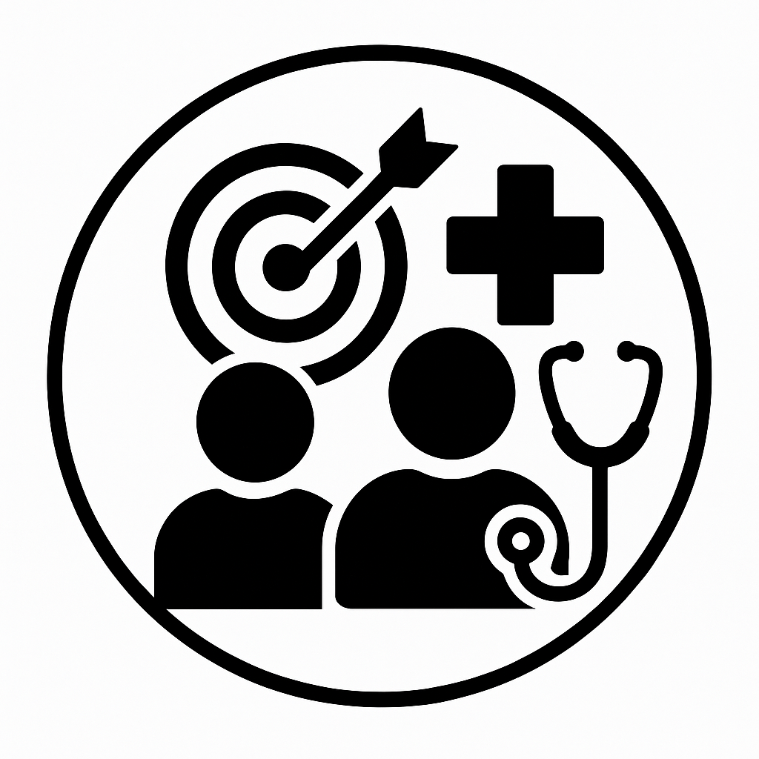
Training Solutions
Rooted in People, Driven by Purpose
Empowering people is the key to setting gold standards in clinical outcomes and human experience.
Building a training ecosystem that merges global best practices with the cultural dynamics of Indian healthcare.
Shyama Dutta brings 20+ years of training and work expertise in leadership, communication, skill matrix mapping, skill gap analysis, skill building, and compliance, with a mission to empower those who heal others.

Slide 7
Thank you

